Slide 1
Blockchain & Incentives
Aparna AidiTh |Omid Meh | Saqib Khan

Slide 2
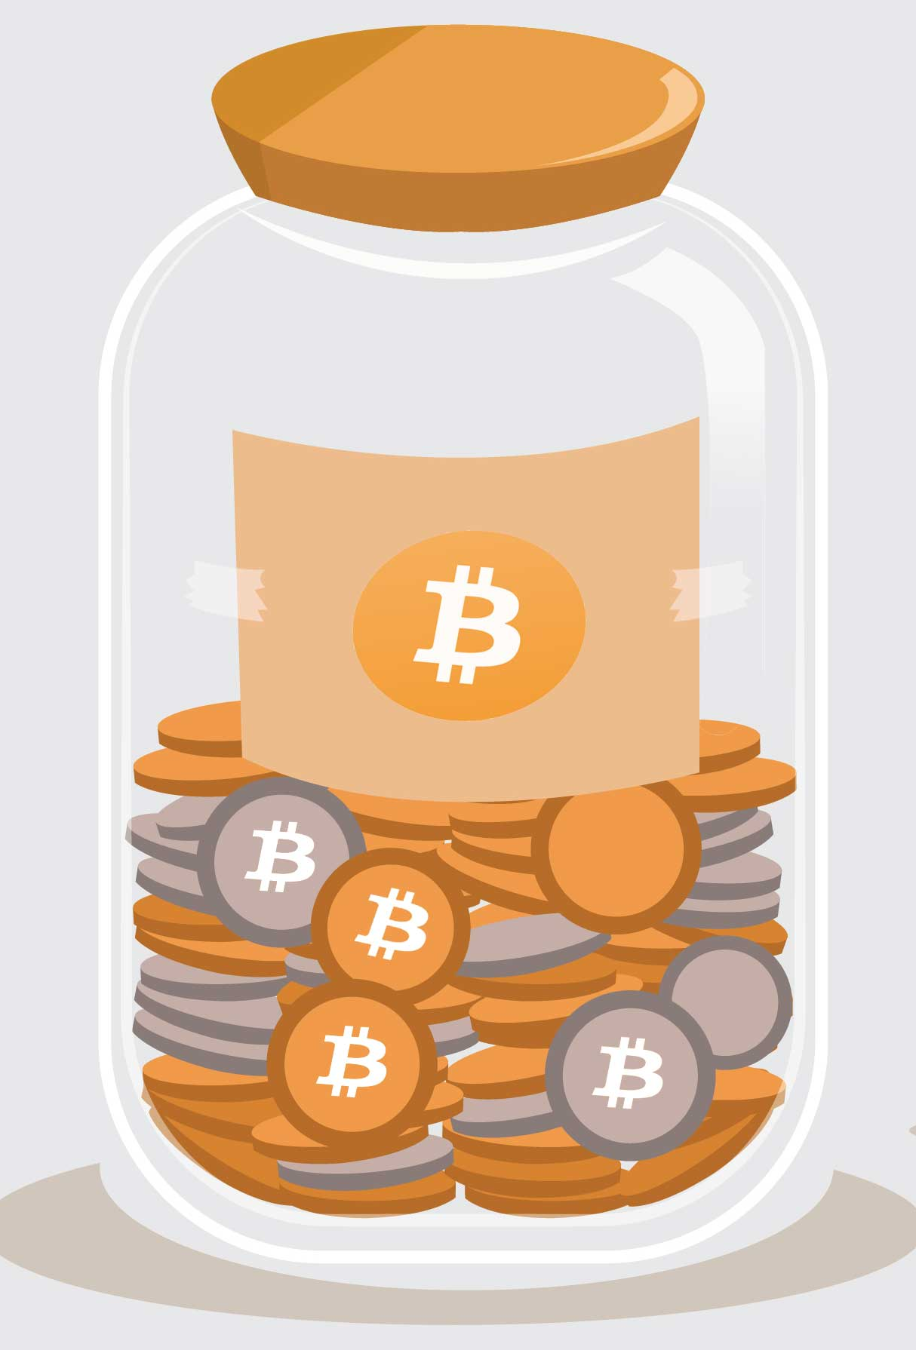
Why is bitcoin amount fixed?
Question:
Answer:
Bitcoin cannot simply be created arbitrarily.
Bitcoin must be mined via digital means.
Linked with this process is the stipulation set forth by the founders of Bitcoin that, like gold, it have a limited and finite supply.
In fact, there are only 21 million Bitcoins that can be mined in total.
Supporters of Bitcoin say that, like gold, the fixed supply of the currency means that banks are kept in check and not allowed to arbitrarily issue fiduciary media.
What will happen when the global supply of Bitcoin reaches its limit?
Critics debate - miners will be forced away from the block rewards they receive for their work once the Bitcoin supply has reached 21 million in circulation. In this case, these miners may need to rely on transaction fees in order to maintain operations.
Supporters debate - miners will then find the process unaffordable, leading to a reduction in the number of miners, a centralization process of the Bitcoin network, and numerous negative effects on the Bitcoin system.
Why does the total amount of bitcoin set to be fixed?
Notes:
Aparna

Slide 3

Storage constraints when running full nodes.
Question
How to fix the problem that as time goes, the chain of blocks becomes longer and longer, which makes mining harder and require more space to construct a full node?
Answer
Use checkpoints
Use Lite Nodes
Subscribe to trusted services which maintain the full nodes for you

Slide 4
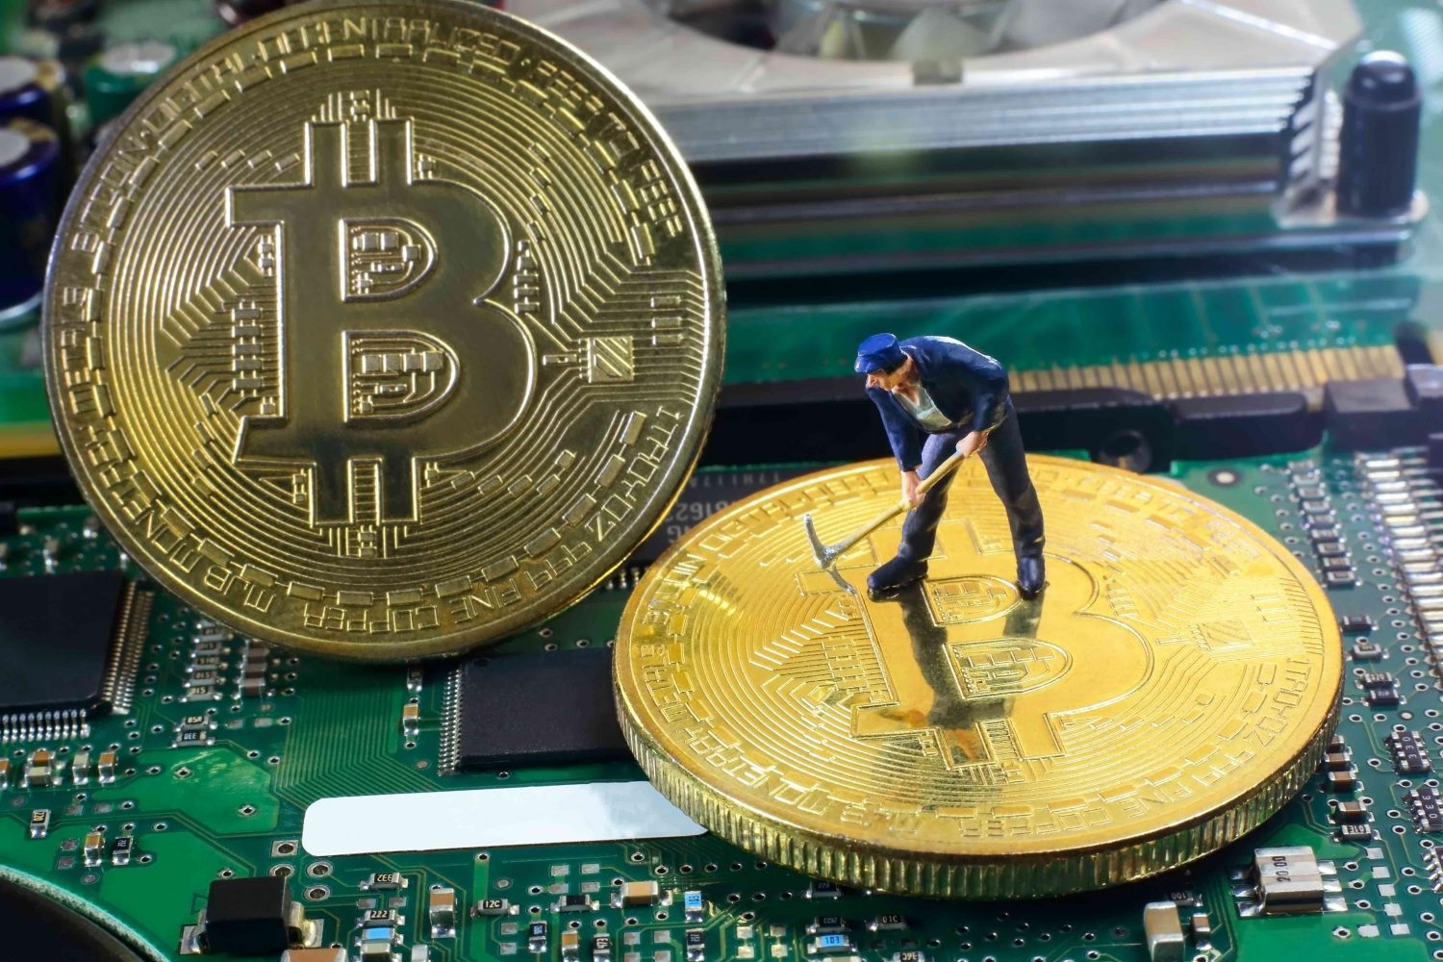
How to incentivize miners?
Questions:
There seems to be a lot of overhead with maintaining a blockchain. At what point does the cost of maintaining the blockchain outweigh its benefits?
How do you incentivize miners when they are working at a loss when Coinbase decreases and more miners join?
As times goes by, the mining reward diminishes, thus giving less incentives to miners. That said, does this mean the service fee for a transaction is going to increase when time goes?
Answer:
Build incentives into the business aspect:
In Bitcoin case, by adjusting network variables:
increase transaction fees / block size
reduce block times
Reduce block difficulty
Difficulty is adjusted every two weeks in bitcoin.
Contract theory (pay-for-performance)
Economics of information
Market design
Increase fees as Coinbase drops

Slide 5
Thank you ☺
Questions?

Slide 6
Backups

Slide 7

Will transaction fees increase?
Question
Would the transaction fee increase when the difficulty to get Coinbase rewards become higher and higher? If so, would that discourage people from using bitcoin?
Answer
Difficulty is adjusted every two weeks in bitcoin.
However, the Coinbase rewards will decrease over time
With 7-8 transactions per block this will lead to increase in transaction costs which will discourage people from using bitcoin.
Will be supplemented by increase in transaction cost.

Slide 8
How to incentivize miners?
Question
There seems to be a lot of overhead with maintaining a blockchain. At what point does the cost of maintaining the blockchain outweigh its benefits? How do you incentivize miners when they are taking a loss and balance the fact that miners are less incentivized to mine as more miners join the network (smaller chance of winning PoW)?
Answer
The point at which the cost of maintaining a node exceeds the net reward (transaction fee + coin based reward), it is no longer profitable to mine.
increase transaction fees
increase block size
reduce block times
reduce block difficulty
Increase coin based reward

Slide 9

Will transaction fees increase?
Question
With time goes by, the reward for building a blockchain decreased. But the difficulty increased, which means a pool need more nodes to solve the hashing problem. This will make the miner gain less. That said, does this mean the service fee for a transaction is going to increase when time goes?
Answer
The difficulty increase because more miners joined the network bringing in more hash power.
Increased difficulty
decreased mining incentive
miners leaving the blockchain
less hash power
re-evaluation of difficulty
increased incentives.

